Slide 1
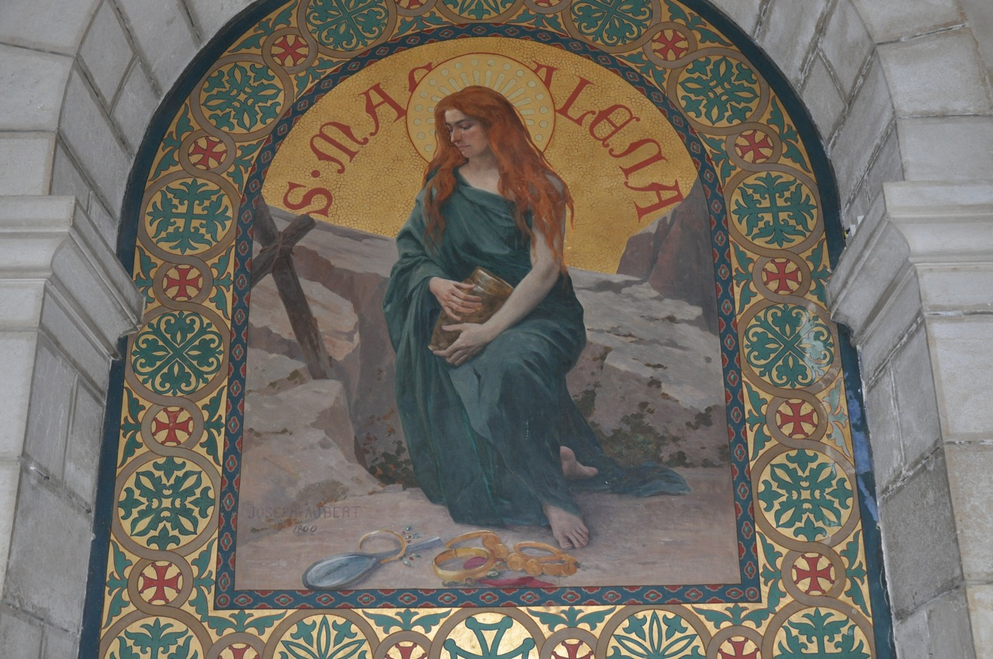
Mary Magdalene A Biblical Snapshot
“Apostle to the Apostles”: A Journey of Discipleship To and From the Empty Tomb

Slide 2
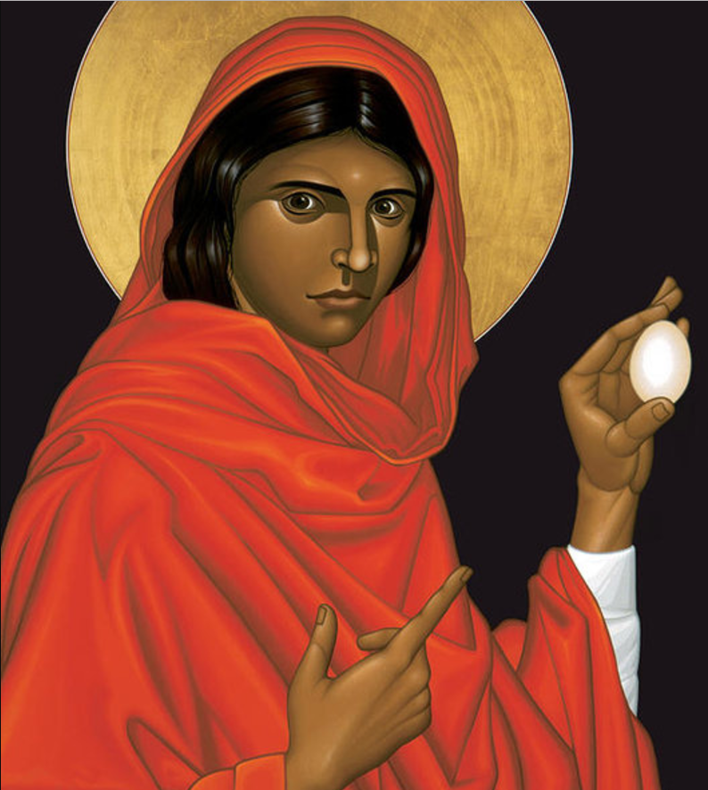
prologue

Slide 3
three pillars of mary magdalene’s discipleship
“I follow the Lord”
“I remain with the Lord”
“I have seen the Lord!”

Slide 4
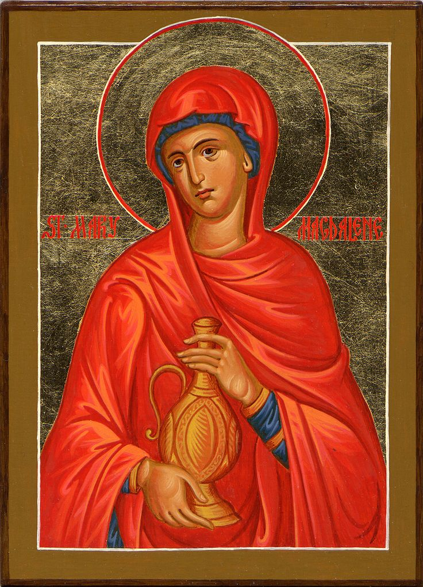
called into discipleship “i follow the Lord”
luke 8:1-8

Slide 5
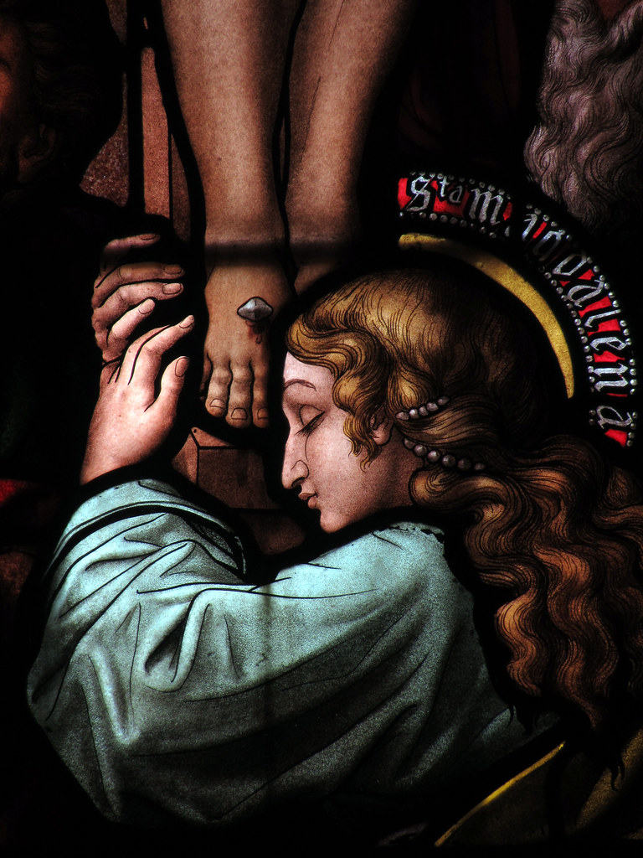
at the foot of the cross “i remain with the Lord”
matthew 27:45-61

Slide 6
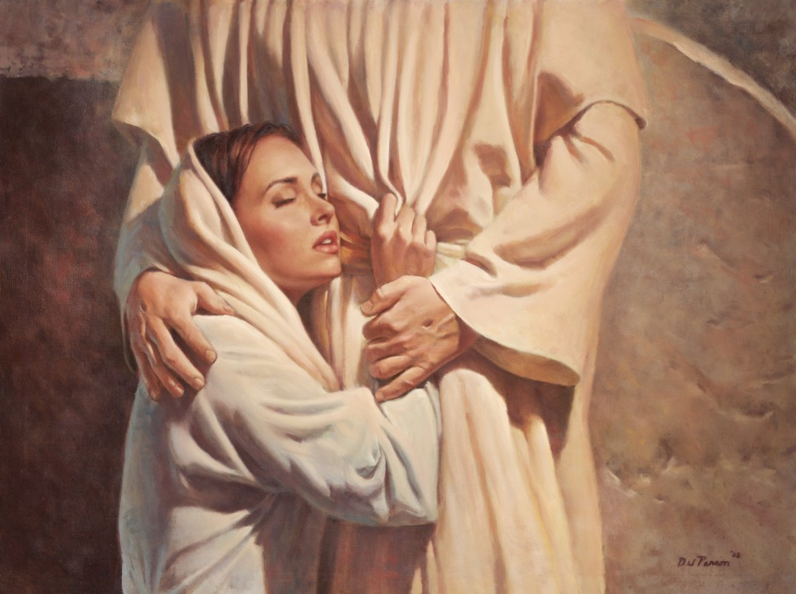
on easter morning “i have seen the Lord!”
john 20:1-18

Slide 7
pope francis & mary magdalene
In recognition of Mary Magdalene’s stature as an apostle, Pope Francis elevated the day [July 22] in the Church calendar that honors her to the rank of FEAST…
“It is right that the liturgical celebration of [Mary Magdalene] should have the same rank of Feast as that given to the celebration of the Apostles in the General Romana Calendar and that the special mission of this woman should be underlined.”
“She becomes an evangelist, that is, a messenger who announces the Good News of the Lord’s resurrection or, as Rabanus maurus and Saint Thomas Aquinas say, she becomes the ‘apostolorum apostola’ because she announces to the apostles what in turn they will announce to the whole world.”
Congregation for Divine Worship

