Slide 1
TIKI TIME SUMMER SCHOOL
OF SPIRITUALITY 2019
SUNDAY MORNINGS

Slide 2
“Anxious WORLD, Anxious people:
how Not to sap your holy spirit”

Slide 3
introduction
“Therefore I tell you, do not worry about your life, what you will eat or what you will drink, or about your body, what you will wear….”
Matthew 6:25

Slide 4
An anxious age
Not talking about “anxiety” in the clinical sense…
Anxiety…worry…distress…impatience…
The inability to deal with uncertainty and the desire to CONTROL inputs and outcomes that is driven primarily by FEAR
Inevitability of… LIFE IS HARD!!
Our world & contributing factors… just a “CLICK” away!
What’s “new,” perhaps, is the INTENSITY of it all
Our white-knuckled grip on life…

Slide 5
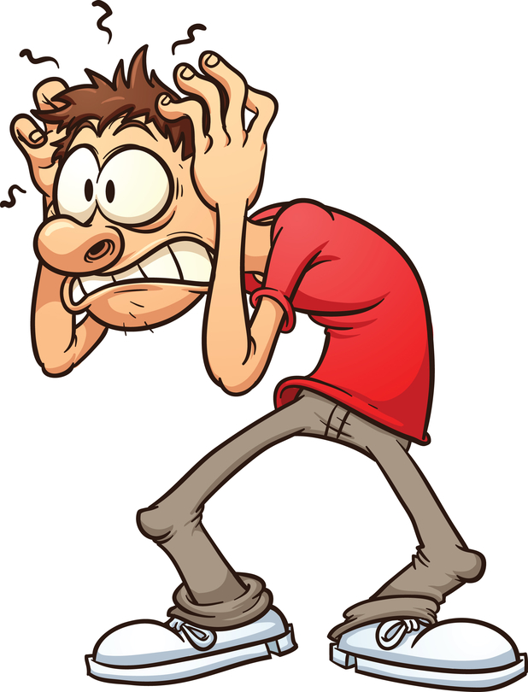
STRESS…
“EXPECTATIONS”… already bear the “seeds” of impatience and anxiety…
“PRE-MEDITATED RESENTMENT”
A little brain science…
PEOPLE…UGH!!!

Slide 6
Emotional triangles
“Lead a life worthy of the calling to which you have been called…with all humility and gentleness, with patience, bearing with one another in love….”
Ephesians 4:2-3

Slide 7
“TRIANGLES” are a fact of life in any relationship system…
“Triangle” = two sides are uncomfortable with their relationships and therefore will focus on a third side to stabilize the relationship with each other
NOTE: the “third side” doesn’t need to be a PERSON…
Words of Wisdom! You cannot change a relationship to which you do not belong…
ANTIDOTE = “Self-Differentiation”, i.e., taking responsibility for one’s own goals/values amidst surrounding “togetherness pressures”

Slide 8
Characteristics of anxious-impatient living
God grant me patience…
AND DO IT NOW!!!

Slide 9
REACTIVITY
HERDING
BLAME DISPLACEMENT
QUICK-FIX MENTALITY
FOCUS = EXTERNAL FORCES

Slide 10
Healthy responses
“Do not worry about anything but in everything, by prayer and supplication with thanksgiving, let your requests be made known to God.”
Philippians 4:6

Slide 11
PLAYFULNESS
GIVE BACK THE PROBLEM
“I NEED TO PRAY ABOUT THIS…”
ASK OPEN-ENDED QUESTIONS…

Slide 12
Guard your “holy spirit”
“Wait for the Lord; be strong , and let your heart take courage;
wait for the Lord!”
Psalm 27:14

Slide 13
IT’S NOT “OUT THERE”…IT’S “IN HERE”…
DON’T EXPECT CONFORMITY TO OUR EXPECTATIONS
DON’T PLAY THE GAME
CHANGE YOUR PACE
WAIT FOR THE LORD!

Slide 14
“the lord, the lord, a god merciful and gracious, slow to anger, and abounding in steadfast love and faithfulness, keeping steadfast love and faithfulness for the thousandth generation….” exodus 34:6

Slide 15
NEXT TIKI SUNDAYJULY 21
“CHRIST PLAYING IN TEN THOUSAND PLACES”:
A GALLERY OF IMAGES

Slide 16
NEXT TIKI MONDAY NIGHT
JULY 8 6:45 pm-8:00 pm
SAINTLY SUMMER PART II
St. Hildegard of Bingen
Adult Treat: Pina Colada & Strawberry Slushies!!

